Slide 1

Tampa Power BI User Group
April 25th,2018

Slide 2
Welcome!
House Items
Thank you to ConnectWise for sponsoring the Food!
WiFi
SSID: CWGuest
username: guest
password: connectwise
Agenda
PUG Tampa Updates
Power BI Features & Updates
Project Professional Program
Notes:
ddd

Slide 3
Power BI Updates – March & April Update
Desktop
Report page tooltips (March)
Buttons to trigger actions (April)
Q&A Explorer & Linguistic schema (April)
Service & Gateway
Persistent filters in the Service and mobile
PBI Embedded Live Demo Tool
PBIRS
Organizational custom visuals
Common Data Services & Roadmap
Notes:
Awesome new updates to the Desktop version (we have been away since the March update!)
Report Page tooltips – amazing ability to now highlight a visual with a Report Page
For those of you who utilize bookmarks (Ted did a presentation on this), then the new Buttons is an AWESOME new feature
Service
Use the new Embedded live tool to test & configure your embedded solutions
New update of Power BI Report Server
Tables/Matrix updates
Storytelling & Apps, better interactively
Organizational Custom Visuals – add Custom Visuals for Creators to use

Slide 4
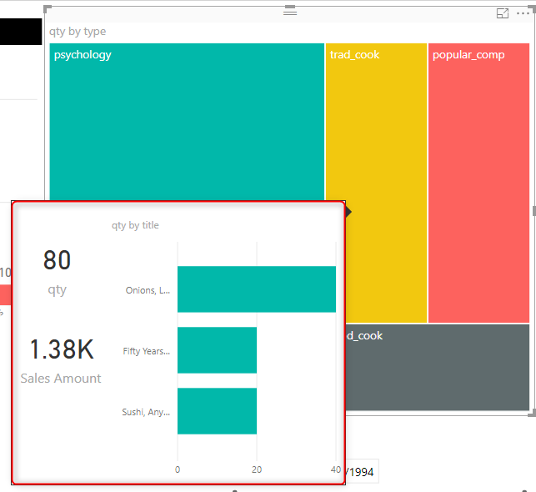
Report Page Tooltips
Report Page Tooltips
Design tooltips for visuals based on a Report page
Full Report page when hovering over a visual
Fully customizable as with a normal page
Filter context passes from visual to tooltip

Slide 5
Add Buttons to Trigger Actions
Add Buttons to trigger actions
Create right from the Desktop Ribbon with extensive formatting options
Add text & colors based on hover or click interactions
Enable Actions for Bookmarks, go Back, or Q&A Explorer

Slide 6

Q&A Linguistic Schema
Q&A Explorer & Linguistic Schema editor
Integrate Q&A right from a Report page
Customize your questions & how Power BI understands your data
Edit how Power BI understands your data & phrasing
Create phrases & relate nouns, adjectives, and verbs to your insights
PowerBI.Tips created a Linguistic Schema editor!
Notes:
Q&A – Return whole pages and carry filters with the Explorer

Slide 7
Power BI Service
Persistent Filters
Power BI will retain the filters/views for your users from each Report
Allows users to pick up where they left off
Easy to reset to default
Power BI Report Server March Update
Updates to Query Editing
Visual interactivity
Notes:
Persistent Filters – amazing way to help users from their last session with a Report
https://powerbi.microsoft.com/en-us/blog/power-bi-report-server-update-march-2018/

Slide 8
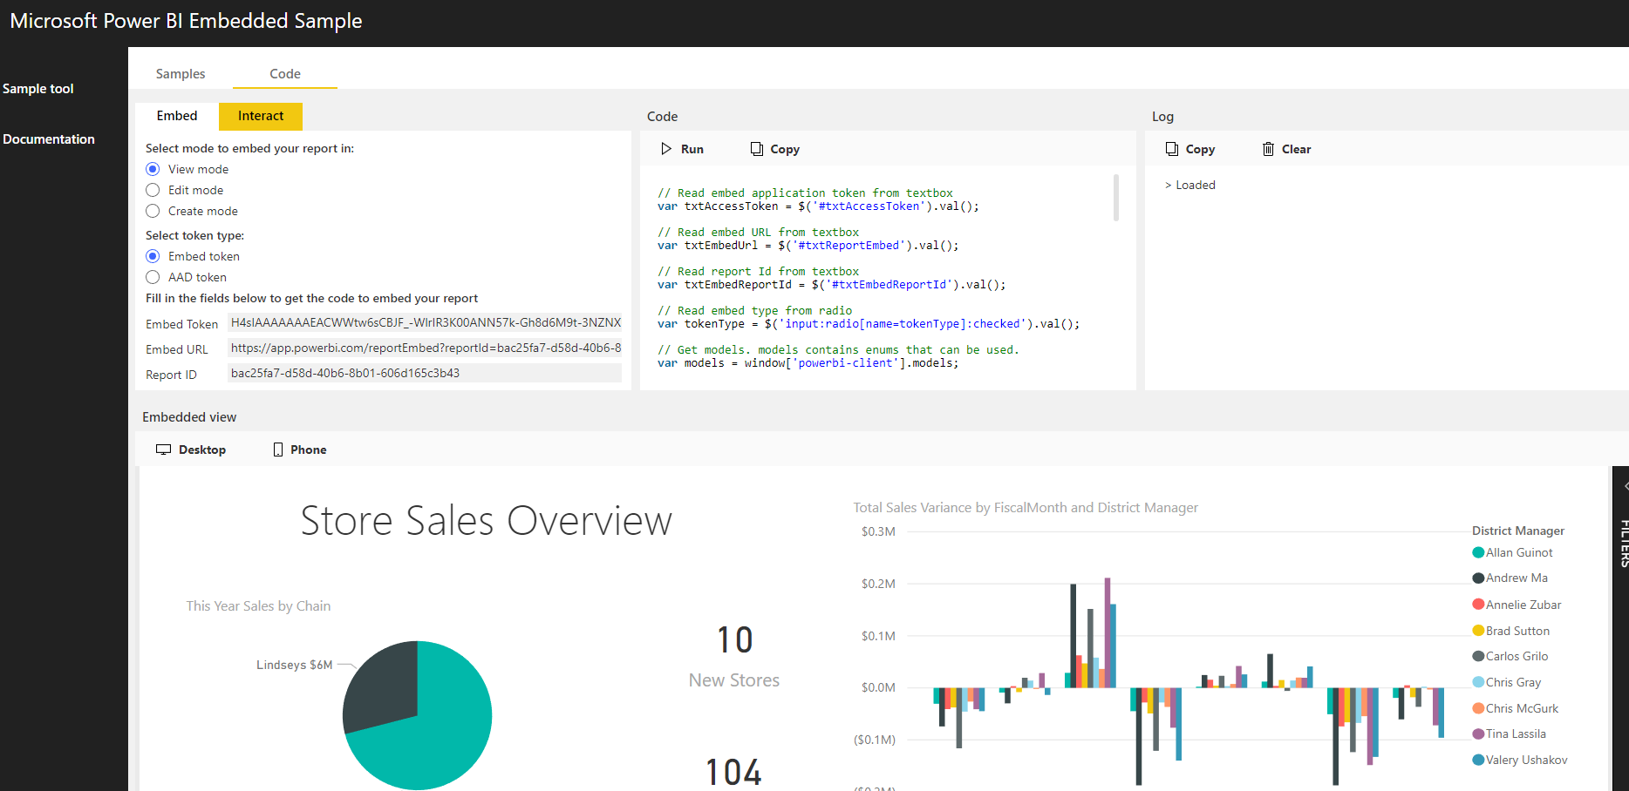
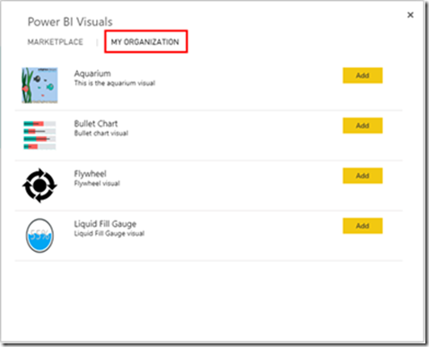
Power BI Developers
New Power BI Embedded Tool
Try features without any code
Explore Embed capabilities
Get results instantly
Power BI Organizational Visuals
Admins can add Custom Visuals for their organization
Notes:
Embedded Tool! https://powerbi.microsoft.com/en-us/blog/power-bi-developer-community-march-update/

Slide 9
Common Data Service Announcements
Integrate data from multiple sources
Incremental Refresh
Query acceleration for large Datasets
SSRS Reports in Power BI Premium
Subscribe other users for email subscriptions
Notes:
Power BI released their Road Map for the year with amazing features on the way
https://blog.crossjoin.co.uk/2018/03/21/power-bi-roadmap-announcements-in-the-dynamics-365-spring-18-release-notes/

Slide 10


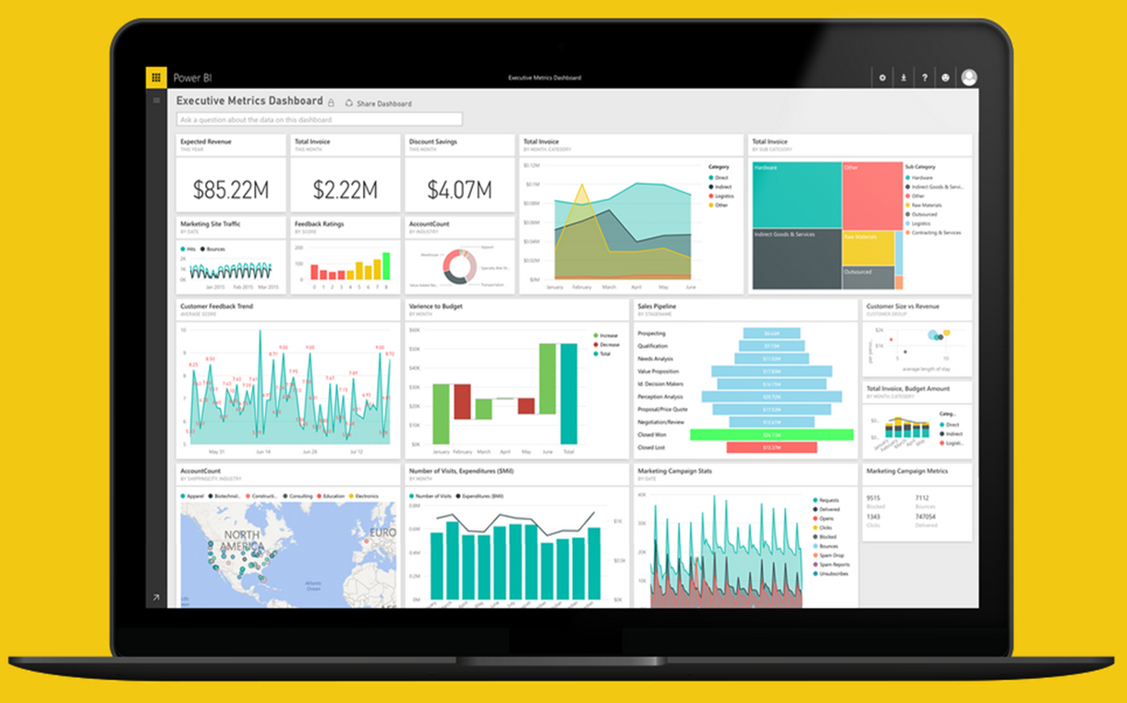
Project Professional Workshop Program
Tampa Power BI User Group
Notes:
We are so excited to introduce the Project professional Program for the Tampa User Group!
Based on the feedback from the previous meetings we had, we realized we want to EMPOWER you to become a skilled PBI professional in your organization and taking the skills and apply them to your career.
This will be part of the upcoming years content & meetings that will culminate with a Contest at the end of the program

Slide 11
Project Professional Program
How it works
Use the “Dashboard in an Hour” format for our meetings
Interactive & guided sessions that focus on best practices and advanced features
Goals
Develop skills using both technical Power BI & business understanding in a BI environment
Effectively apply data storytelling & communication using the Power BI platform
Notes:
So what does this mean for the User Group Meetings?
You are going to need your computer!
We are going to focus on interactivity and building a Power BI solution together from start to finish
Not just Technical – we are going to begin with a problem statement or request.
We want at the end of the program you to be able to take a project and know the right approach to a Report
Understand how to use the skills for storytelling
Apply best practices to create powerful analysis
Hopefully – be able to take the MCP!

Slide 12
Project Professional Program
What you are going to learn
Expertise in Power BI features & tools
Query Editor
DAX
Data Modeling
Data Visualization
Problem Solving Skills to approach common BI use cases
Business Understanding on approaching data
Notes:
Is this right for you? We know people are at various skill levels.
Regardless, we want to not just teach but actually challenge you to think a different way based on the use cases
Even if you know the basics, we are going to build HOW you approach a Report
And with the large amount of features in Power BI, we are going to grow your arsenal

Slide 13
Project Professional Program – FAQ
What do I need every meeting?
Bring you laptop that has Power BI!
What is the skill requirements?
Basic understanding of Power BI Desktop and creating Reports. While you do not need advanced skills, our focus is to grow from basic to advanced understanding of Power BI
Do I need to attend every meeting?
We hope you can! While not a requirement, each meeting will follow along a certain dataset and project. We will supply all the resources needed for each meeting beforehand however.

Slide 14
Module 1 – Discovery
Notes:
So let’s talk about our approach and discovery. Before you know the skills or even if you are a skill master, if you do not know your data then you are going to have a difficult time.

Slide 15


Who are we?
VanArsdel
Manufactures and sells sporting goods
Sales come from its own manufactured products and other manufactures
Sells directly to consumers nationwide & international
The Request
The CMO wants a sales & market share analysis
How well do VanArsdel’s products sell compared to 3rd Party?
How do we perform nationwide vs. international for our products?
What product categories and segments show recent trends
How do we compare this year vs. last year?
Notes:
So let’s start with who are we and what are we dealing with?
We work at a company named VanArsdel – they manufacturer and sell sporting goods. They sell 3rd party and their own.
We are on the Data Analyst at the company – we work with the Marketing & Sales department.
There is a growing concern at the company that VanArsdel’s own products are struggling compared to similar 3rd Party products. The product team needs to know what to focus their time on, and the CMO wants to see where VanArsdel has the greatest opportunity.
Not only this, but it cost more to sell 3rd Party products outside the US – how does nationwide vs. Int. compare?

Slide 16
Where do we Start? Ask the Right Questions
Start with answering basic questions about your project
What Data do we need?
What fields and tables are required to answer the questions?
What Data do we have?
What do I have currently have that is relevant to this project?
What Data do we transform?
What data do I need to optimize to be in the correct shape?
Notes:
So know we know the challenge, where the heck do we start?
Any solution or Report you work always begins with getting data. With this in mind, you should ALWAYS ask and answer 3 basic questions before you start on any visual.
This applies even if you know the data and have been working with the same data for years. Each request and solution is different.
What Data do we need? Always document what fields and data you must have.
What are the main metrics, values, and fields that you will be reporting on? What do you need to help describe your data (rolling up, grouping)?
What Data do we have? Where does is the data coming from?
Once you know what you need and how you need it, you can begin to acquire the right sources. What about the formats/types of it? Does it work?
What Data do we transform?
If you do not have what you need originally, this is where we start so we can create or remodel and get what we need.

Slide 17
What Data do we Need?
Small Group Time! Get together and document the needed tables/columns, etc.
What am I counting or aggregating?
Include what aggregations (measures) and facts needed
Transactions
Revenue
Cost
How do we Describe the Data?
Include what dimensions and attributes that must describe the “facts” and be able to roll up into
by Month
by Customer
By GEO
Notes:
So let’s do this together – based on the scope of the project, get into groups of about XX to write down what you think you need.
Make sure to document both what are the Facts (counting or aggregating) and what dimensions you need (what describes the facts).

Slide 18
What Data do we Need – Exercise
Document the following:
What do I need aggregate or count?
What is required to describe and provide granularity to my facts?
The Request
The CMO wants a sales & market share analysis
How well do VanArsdel’s products sell compared to 3rd Party?
How do we perform nationwide vs. international for our products?
What product categories and segments show recent trends
How do we compare this year vs. last year?

Slide 19
What Data do we Have?
Explore the Data! (USSales Folder)
Import the data into a new Power BI Model
What is the source of the data?
What is the formats?
What is the current shape?
How does this match with what we Need?
What am I counting?
What am I describing?
What is missing or is the wrong shape?
Notes:
Ok – with the basis of what you need, let’s start by importing the data.
We have 2 files. A Sales file in CSV and a Dimension file as Excel Workbook.
Go through it and see if this goes back what you need.

Slide 20
What Data do we Have - Exercise
BI_Dimension file – Excel
Product Table
ProductID
Category (missing data)
Price (not number) Product (Not Split)
GEO - sheet
As sheet – not clean
Wrong Data types
Manufacturer – sheet
Not right layout (columns)
Sales file – csv
Facts
Units
Revenue
Dimensions
ProductID
Date
Zip
ManufacturerID
Notes:
The Sales file is just US, and we see the following:
ProductID, Date, Zip, ManufacturerID for our dimensions.

Slide 21
What Data do we Transform?
What transformations are needed?
One file is a CSV (Sales transactions or Fact Table)
We need to describe sales by Product (category, type), Manufacturer, GEO
The BI_Dimension excel file has multiple worksheets…
What to fix
How do we format Product?
How do we format Manufacturer?
GEO?
Notes:
Ok, so now that we have explored what we have, we know that we need to optimize the shape of some the data.

Slide 22
Ask the Right Questions
What Data do we need?
Product Sales that contain information on location, date, manufacturer, product details
What Data do we have? (USSales Folder)
Sales table (sales.csv) & Dimension Excel file
Current Shape is wrong for some dimension files
What Data do we transform?
Reshape Manufacturer file to have unique ID
Optimize Product table to be able to report
Fix GEO table to match to Sales Zip

